Slide 1
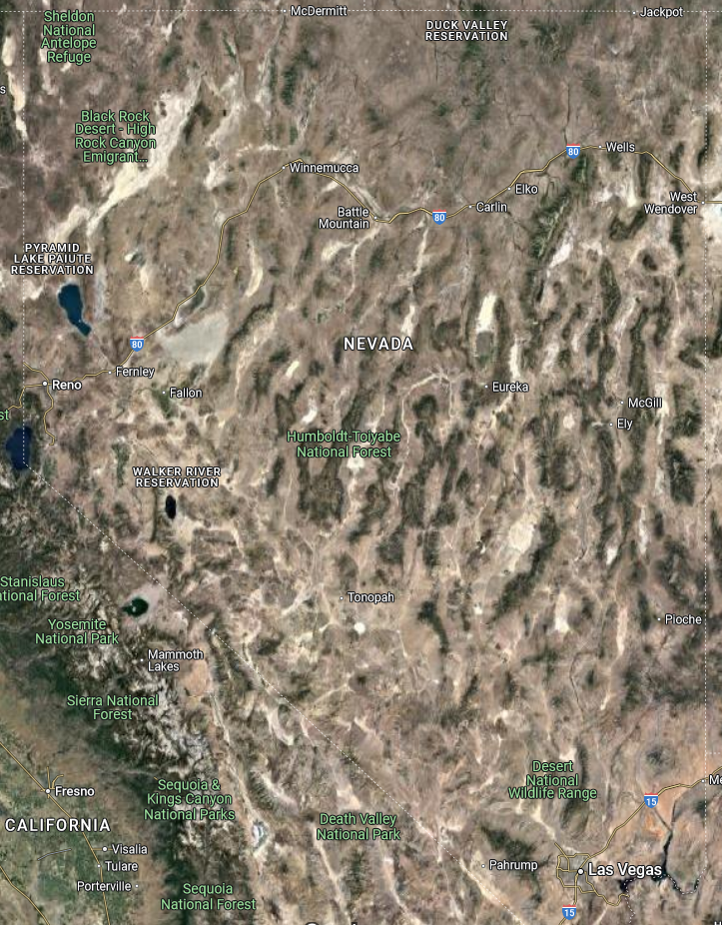
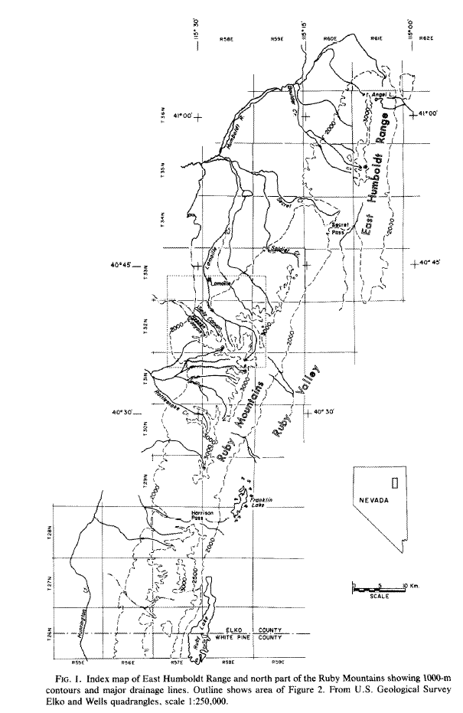
Pleistocene Glaciation in the Ruby-East Humboldt range, northeastern Nevada
Summary of papers by Robert P. Sharpe (1938) and William J. Wayne (1984)
By Maggie Duncan, 2024
Purpose of Papers:
4a (Sharpe, 1938): To examine morphological evidence of glaciations in the Ruby-East Humbolt range and make preliminary estimates of separate glaciations during the Pleistocene
4b (Wayne, 1984): To improve upon Sharpe’s relative age estimates and correlation of glaciations using updated techniques (air photos, relative dating, new road cuts)

Slide 2
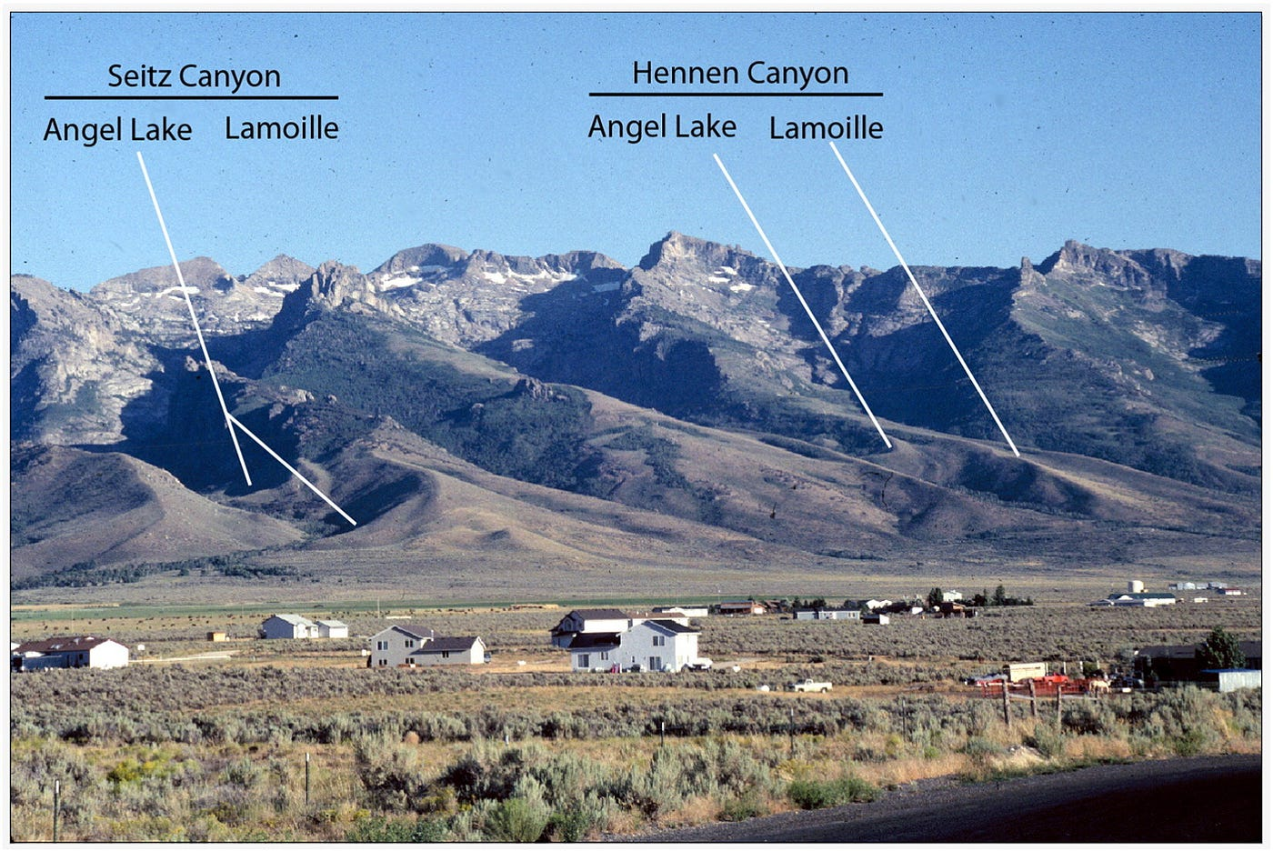
Two main glaciations during the Pleistocene
Lamoille (older)
Angel Lake (AL; younger)
Evidence
Glacial topography – u-shaped valleys, cirques, moraines, glacial polish
Inset of LA moraines into Lamoille moraines
No Lamoille terminal moraines within canyons
Well-preserved AL terminal moraines within canyons
Relative weathering, soil profile development
Western front of Ruby range, looking east.
Source: C. Joy, Medium.com
Notes:
Wayne builds off the research of Sharpe by implementing updated relative age dating techniques. Still no qualitative assessment of ages.

Slide 3
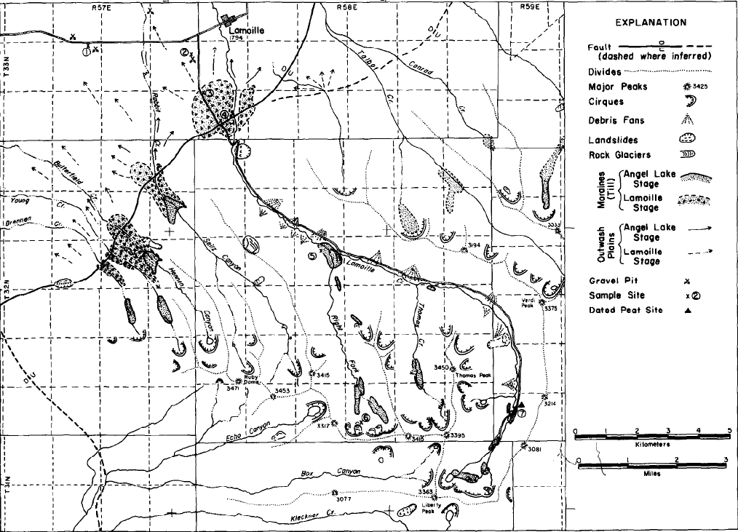
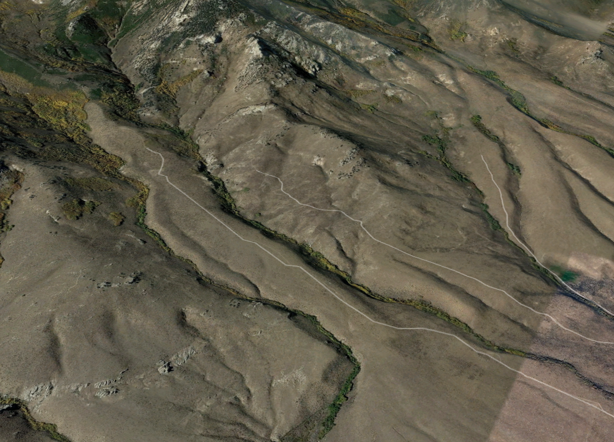
Glacial Characteristics – Evidence for Relative Ages
 | Lamoille | Angel Lake
Terminal Elevation | Average ~2230 m (west side), 2190 m (east side) 1860 m at mouth of Lamoille Canyon | Average ~2380 m (west side), 2320 (east side)
Glacial extent | Emerged from mountains onto piedmont slope | Approx. 80% of Lamoille glacier extent
Moraines | Extend lower into valley and higher up canyon walls Less ‘bouldery’, but more quartzite boulders More eroded, rounded, subdued, incised by streams | Terminate at higher elevations; sit inside Lamoille moraines Abundant boulders & subrounded granite clasts Sharper, fresher
Angel Lake
Lamoille
Wines Creek, Eastern side of Ruby Mountains. AL lateral/terminal moraines are sharper and more bouldery.
Lamoille stage tills and outwash plains extend further into valley.
Notes:
Lamoille soil profiles in moraines suggest erosion of weathered materials (ie clays) happening at same rate as formation
*Note: only 6 soil profiles (4 from L and 2 from AL) were taken.

Slide 4
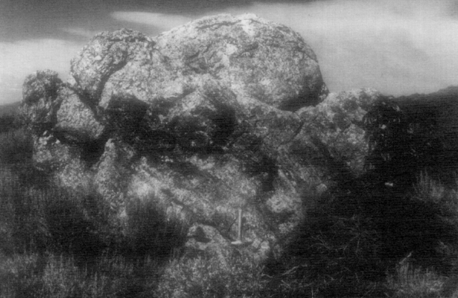
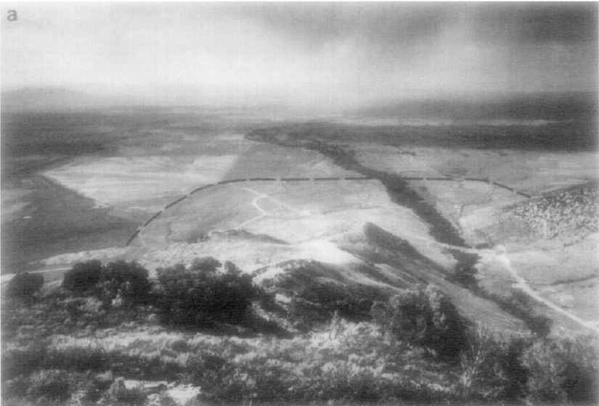
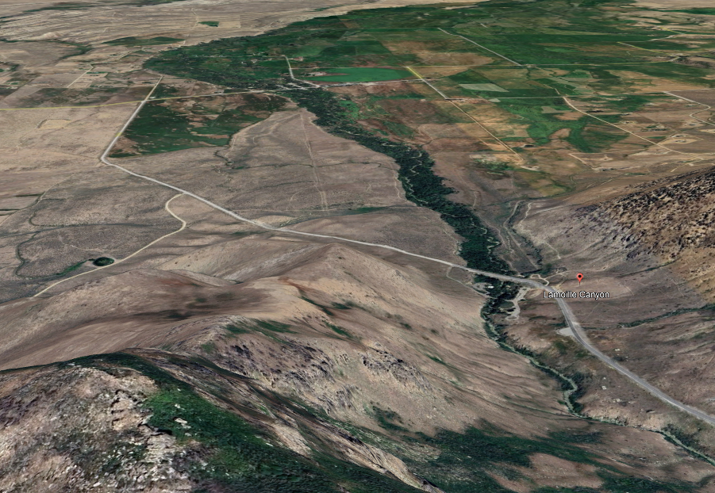
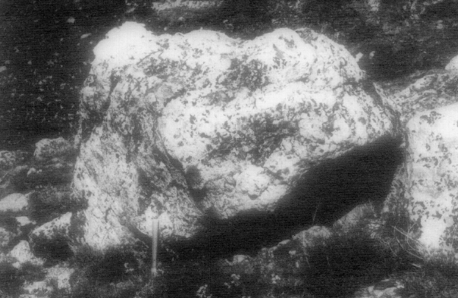
Glacial Characteristics – Evidence for Relative Ages
 | Lamoille | Angel Lake
Boulders | Strongly weathered, pitted, rounded/subrounded grus common Generally thicker weathering rinds Split/fractured/rounded quartzite Pong! | Weathered, subrounded granitic boulders, but little grus Rocks generally lack weathering rinds Quartzites show little to no weathering Ping!
Outwash Plains | Reach lower elevations in valley Well-sorted, gravelly, cross-bedded sediments Fan-like distribution | bouldery, less bedding No fan-like distribution; restricted to montane and creek valleys
Outwash of Lamoille stage
Lamoille
AL outwash
Lamoille terminal moraine
Angel Lake
Mouth of Lamoille Canyon looking east.
Notes:
Lamoille soil profiles in moraines suggest erosion of weathered materials (ie clays) happening at same rate as formation
*Note: only 6 soil profiles (4 from L and 2 from AL) were taken.

Slide 5
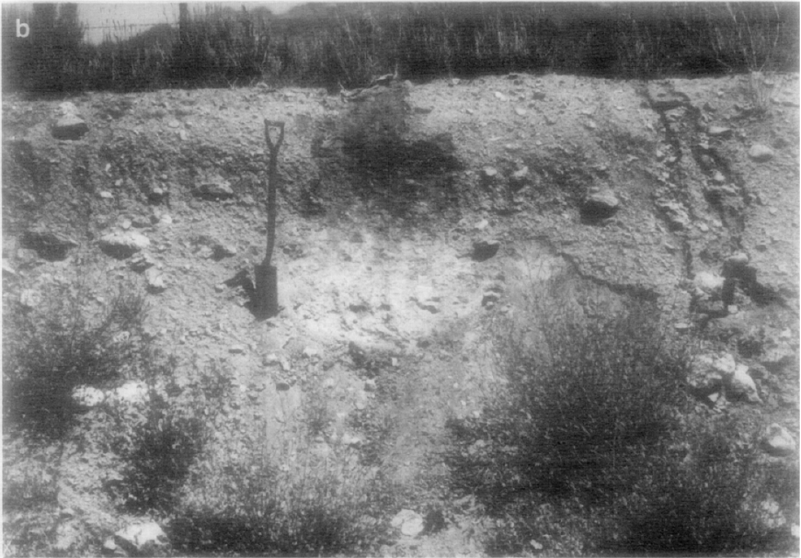
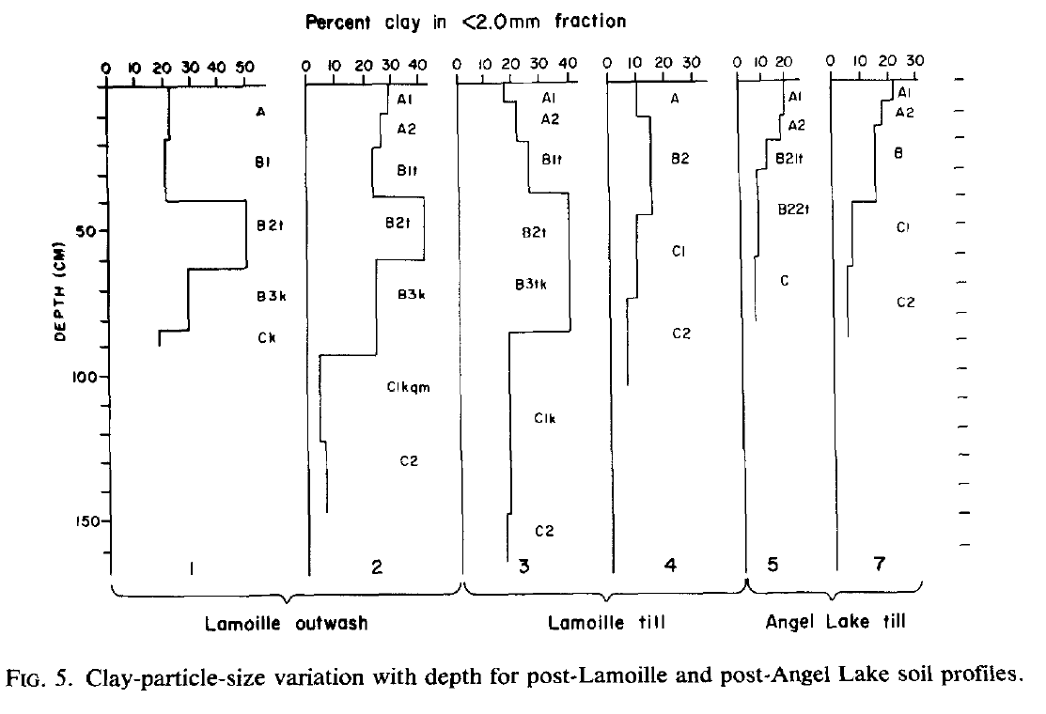
Glacial Characteristics – Evidence for Relative Ages
 | Lamoille | Angel Lake
Soil-Profile | Well-developed solum (≥ 2x thicker than LA) Thicker B horizon with clay development and structure Iron staining | Thinner, less developed solum Generally lower clay faction
Lamoille stage terminal moraine soil profile – blocky, thick B horizon with ~40% clay (Fig. 5.3). Indicates long formation time.
Notes:
Lamoille soil profiles in moraines suggest erosion of weathered materials (ie clays) happening at same rate as formation
*Note: only 6 soil profiles (4 from L and 2 from AL) were taken.
Solum: upper layers (A and B horizons) of a soil profile where mineral and organic matter is transferred, added, removed, etc. through soil formation processes.

Slide 6
Relative Age Estimates
W
E
Ruby-East Humboldt Range
Sierra Nevada
Rockies
Central U.S.
Tioga stage
Angel Lake stage
(≥13,000 ± 900 yr BP)
Pinedale stage
Wisconsinan Glaciation
(~70 – 11 k BP)
Time
Tahoe stage
Lamoille stage
(~130,000 yr BP?)
Bull Lake stage
Illinoian Glaciation
(~180 -125 k BP)
One radiocarbon date from peat accumulation on AL till dated at 13,000 ± 900 yr BP.
Wayne concluded that Lamoille till may be up to an order of magnitude older than Angel Lake based on relative age estimates.
Significant difference in boulder weathering/erosion and soil profile formation suggests large time interval between deposition of Lamoille and AL moraines.

